Slide 1
Sentiment Analysis
– Devender Singh

Slide 2
What is Sentiment Analysis?
Sentiment Analysis also known as Opinion Mining is a field within Natural Language Processing (NLP) that builds systems that try to identify and extract opinions within text. Usually, besides identifying the opinion, these systems extract attributes of the expression e.g.:
Polarity: if the speaker express a positive or negative opinion
Subject: the thing that is being talked about
Opinion holder: the person, or entity that expresses the opinion.

Slide 3
What Is an Opinion?
Before going into further details, let's first give a definition of opinion. Text information can be broadly categorized into two main types: facts and opinions. Facts are objective expressions about something. Opinions are usually subjective expressions that describe people’s sentiments, appraisals, and feelings toward a subject or topic.
Sentiment analysis, just as many other NLP problems, can be modeled as a classification problem where two sub-problems must be resolved:
Classifying a sentence as subjective or objective, known as subjectivity classification.
Classifying a sentence as expressing a positive, negative or neutral opinion, known as polarity classification.

Slide 4
Direct vs Comparative Opinions
“The picture quality of camera A is poor.” – Direct Opinion
“The picture quality of camera A is better than that of camera B.” – Indirect Opinion
Explicit vs Implicit Opinions
“The voice quality of this phone is amazing.” – Explicit Opinion
“The earphone broke in two days.” – Implicit Opinion
Sentiment Analysis Scope
Document level
Sentence level
Sub-sentence level

Slide 5
Types of Sentiment Analysis
1) Fine-grained Sentiment Analysis
Very positive
Positive
Neutral
Negative
Very negative
2) Emotion detection
Emotion detection aims at detecting emotions like, happiness, frustration, anger, sadness, and the like.

Slide 6
Types of Sentiment Analysis ( cont.)
3) Aspect-based Sentiment Analysis
“The battery life of this camera is too short.”
4) Intent analysis
“Your customer support is a disaster. I’ve been on hold for 20 minutes”.
“I would like to know how to replace the cartridge”.
5) Multilingual sentiment analysis

Slide 7
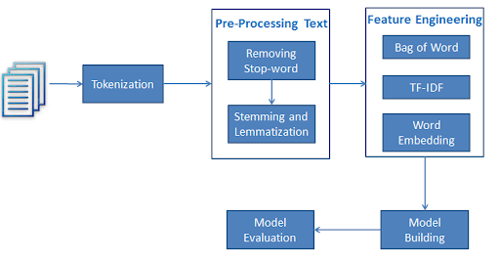

Slide 8
Pre-processing
An initial step in text and sentiment classification is pre-processing. A significant amount of techniques is applied to data in order to reduce the noise of text, reduce dimensionality, and assist in the improvement of classification effectiveness. The most popular techniques include:
Remove numbers
Stemming
Part of speech tagging
Remove punctuation
Lowercase
Remove stopwords

Slide 9
How to classify Sentiment?
Machine Learning
This approach, employes a machine-learning technique and diverse features to construct a classifier that can identify text that expresses sentiment. Nowadays, deep-learning methods are popular because they fit on data learning representations.
Lexicon-Based
This method uses a variety of words annotated by polarity score, to decide the general assessment score of a given content. The strongest asset of this technique is that it does not require any training data, while its weakest point is that a large number of words and expressions are not included in sentiment lexicons.
Hybrid
The combination of machine learning and lexicon-based approaches to address Sentiment Analysis is called Hybrid. Though not commonly used, this method usually produces more promising results than the approaches mentioned above.

Slide 10
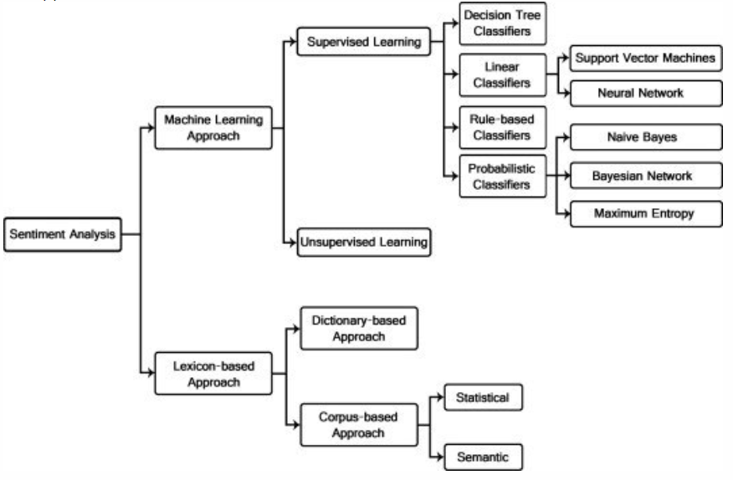

Slide 11
Experiment 1 – Classifying Tweets based on Racism
The objective of this task is to detect hate speech in tweets. For the sake of simplicity, we say a tweet contains hate speech if it has a racist or sexist sentiment associated with it. So, the task is to classify racist or sexist tweets from other tweets.
Dataset - Formally, given a training sample of tweets and labels, where label ‘1’ denotes the tweet is racist/sexist and label ‘0’ denotes the tweet is not racist/sexist, your objective is to predict the labels on the given test dataset.
Tweets Preprocessing and Cleaning
A) Removing Twitter Handles (@user)
B) Removing Punctuations, Numbers, and Special Characters
C) Removing Stop Words
D) Tokenization
E) Stemming

Slide 12
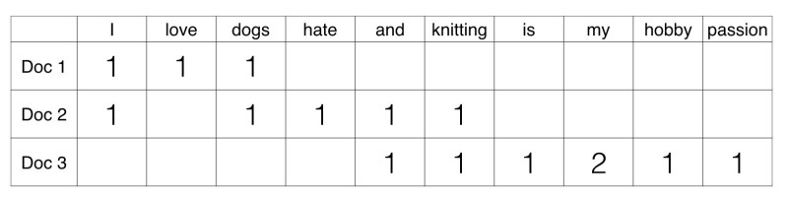
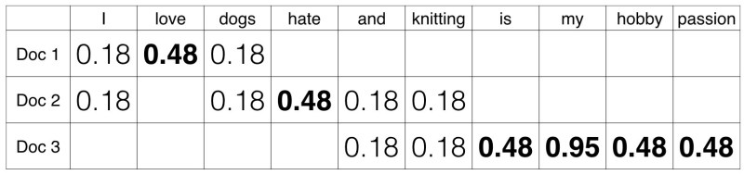
Extracting Features from Cleaned Tweets
Two Approaches
1) Bag-of-Words Features
2) Tf-Idf

Slide 13
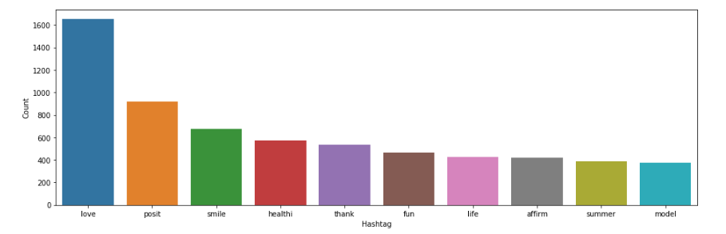
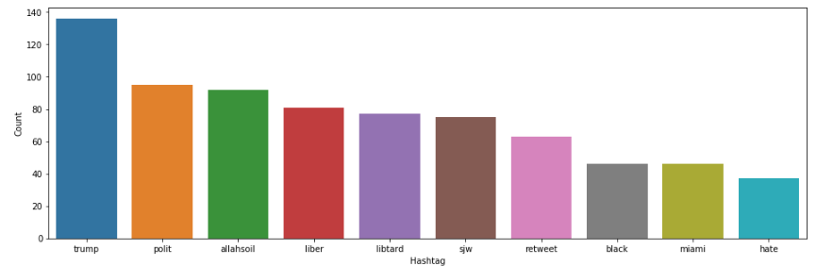
Positive Tweets Hashtags
Racist/Sexist Tweets Hashtags

Slide 14
Model Building: Sentiment Analysis
Classification Algorithms
The classification step usually involves a statistical model like Naïve Bayes, Logistic Regression, Support Vector Machines, or Neural Networks:
Naïve Bayes: a family of probabilistic algorithms that uses Bayes’s Theorem to predict the category of a text.
Linear Regression: a very well-known algorithm in statistics used to predict some value (Y) given a set of features (X).
Support Vector Machines: a non-probabilistic model which uses a representation of text examples as points in a multidimensional space. These examples are mapped so that the examples of the different categories (sentiments) belong to distinct regions of that space.. Then, new texts are mapped onto that same space and predicted to belong to a category based on which region they fall into.
Deep Learning: a diverse set of algorithms that attempts to imitate how the human brain works by employing artificial neural networks to process data.

Slide 15
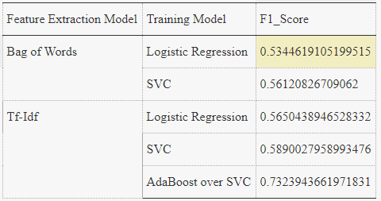

Slide 16
Experiment 2 – Classifying IMDB Review
The objective of this task is to detect sentiment in reviews given by the viewers and critics to the movies or TV shows. So basically to classify the review based on sentiment could be positive or negative.
Dataset – Given a labeled and unlabeled data of reviews. Count of labeled review is 25k and that od unlabeled ones is 50k. In the Labeled Dataset, 1 corresponds to a positive review and 0 to negative one.
The reviews were classified based on both the approaches
Machine Learning for Labeled data
Lexicon Based for unlabeled data

Slide 17
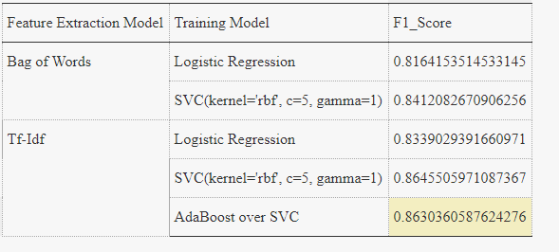
Machine Learning Approach for Labeled data
- results are obtained following the same approach as in Experiment 1

Slide 18
Lexicon Based Approach for unlabeled data
This basically includes 3 steps
Text Preprocessing and Cleaning. This step includes removing punctuation marks, removing stopwords, tokenisation and stemming.
Calculating polarity of each word in the review followed by the total polarity of the review. This is done for all the reviews in the dataset.
Classifying the review based on the total polarity score

Slide 19
Tools used for Calculating Polarity
Nltk – a module for natural language processing.
WordNet – a dictionary in nltk
SentiWordNet is a lexical resource for opinion mining that assigns to each synset of WordNet three sentiment scores: positivity, negativity, and objectivity.
Wordnet was used to extract the most common meaning of a word and SentiWordNet would return the polarity of the word
SentiWordNet returns +ve and –ve polarity score of a word depicting positivity and negativity in a word.
A total polarity score is calculated by subtracting the summation of negative scores from the summation of positive scores, which would help us in classifying the whole review.
When the classified text(Imdb reviews) were checked and reviewed, 65% of the reviews were correctly
classified.

Slide 20
References
Getting Started with Sentiment Analysis - https://nlpforhackers.io/sentiment-analysis-intro/
The Basics of Sentiment Analysis - https://monkeylearn.com/sentiment-analysis/
Scikit Learn - https://scikit-learn.org/stable/tutorial/index.html
Kaggle (For the datasets) – https://www.kaggle.com/
AdaBoost Classifier in Python - https://www.datacamp.com/community/tutorials/adaboost-classifier-python

Slide 21
What Did I Learn?
Introduction to Machine Learning and its uses cases
Supervised and Unsupervised Machine Learning
Explored some modules such as numpy, pandas, seaborn, matplotlib, nltk, scikit-learn
Learned and explored various Classification algorithms such as SVM, Logistic Regression, Random Forest
Learned about boosting algorithms
Understood the domain of sentiment Analysis.
Cleaning and preprocessing data
Thanking Avinash Navlani Sir

